Slide 1

PREDICTIVE MODELING FOR LENGTH OF STAY USINGMACHINE LEARNING
Varun Ravichandran, Dedeepya Ravipati, Sai Krupa Chinthakunta &
Rathnakar Rajanala

Slide 2

Conflict
The authors declare no conflicts of interest.

Slide 3
Introduction & Background
LoS impacts hospital efficiency, cost, bed utilization
Traditional statistical models miss nonlinear patterns
Machine learning offers complex interaction modeling
Aim: develop & compare ML models for LoS prediction

Slide 4
Methods
Data source: Kaggle (demographics, clinical, billing)
Preprocessing:
Impute missing (median/mode), encode categoricals
Log-transform billing, scale numerics
Modeling:
Algorithms: LR, DT, RF, XGBoost, NN, KNN, SVR
GA for feature selection + SHAP for interpretation
Validation: 80/20 split, 3-fold CV

Slide 5
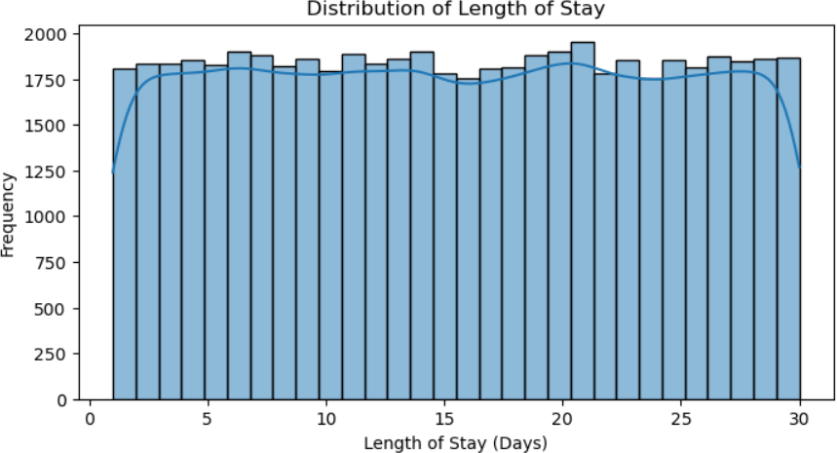
Results (Exploratory & EDA)
Bulk of patients stay ≤ 10 days, showing a strong left concentration.
Right-skewed tail (up to ~30 days) highlights a subset of long-stay outliers.

Slide 6
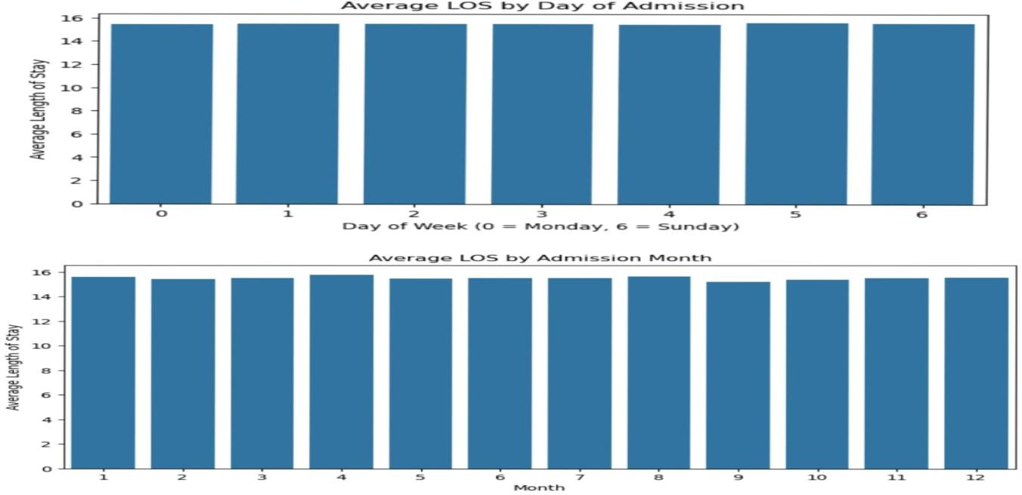
Results (Exploratory & EDA)
Emergency admissions average ~12 days vs. ~9 days for elective (~30% longer).
Urgent admissions fall between, demonstrating clear ordering by severity.

Slide 7
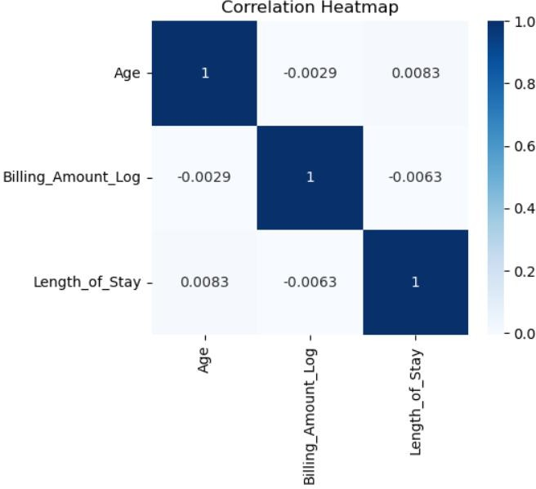
Feature Relationships (Heatmap)
Billing_Amount_Log and Age show strongest positive correlations (darker cells).
Gender and Blood_Type near-zero correlation (light cells), indicating low predictive value.

Slide 8
Results (Model Performance)
Model | RMSE (days) | R²
Random Forest (RF) | 8.36 | 0.07
XGBoost (XGB) | 8.79 | –0.03
Linear Regression (LR) | 8.66 | 0.00
Decision Tree (DT) | 11.79 | –0.85
Neural Network (NN) | 8.68 | –0.00
K-Nearest Neighbors (KNN) | 9.37 | –0.17
Support Vector Regression | 8.67 | –0.00

Slide 9
Results (Model Performance)
RF lowest error (8.36 days)
DT worst (~11.8 days)
Ensemble methods cluster 8.3–8.8 days

Slide 10
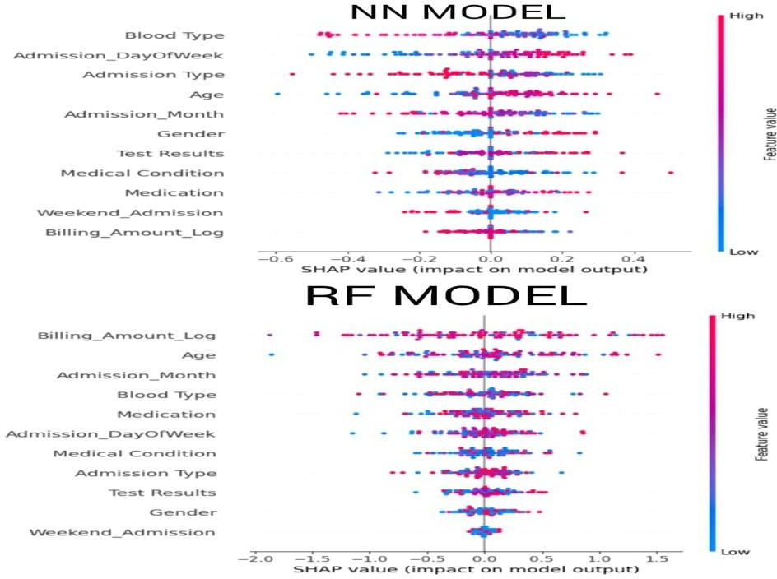
Results (Interpretability & Optimization)
High billing pushes LoS ↑
Low billing pulls LoS ↓
Age & month secondary

Slide 11
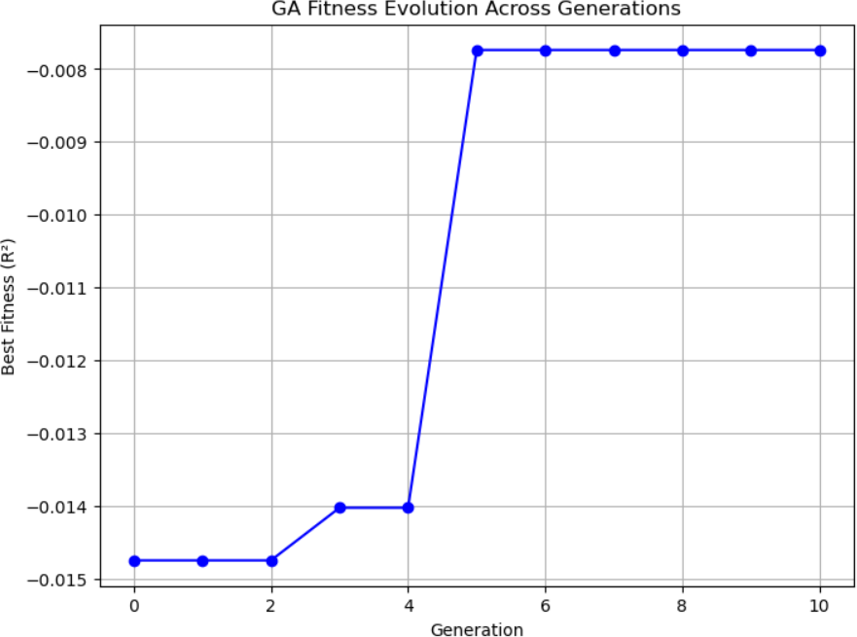
Results (Interpretability & Optimization)
Converged by gen 3
Only “Medical Condition” retained
Suggest larger GA runs needed

Slide 12
Limitations
Limited clinical/lab variables → weak signal
Billing linked to LoS may leak information
Small GA population & generations → suboptimal selection

Slide 13
Conclusions
RF best but explains only ~7% variance
Key drivers: billing, age, admission timing
SHAP & GA workflows useful to validate & highlight gaps

Slide 14
Acknowledgements
Thanks to Dr. Divya S. Subramaniam & Dr. Dipti P. Subramaniam
Data source: Kaggle Healthcare dataset
Any funding or institutional support

Slide 15
